Slide 1
Vector Search Gilead - 26 JAN 2024
Brad Barker
SSA, Healthcare and Life Sciences

Slide 2
Confidential & Subject to Change
The following is intended to outline our general product direction.
We constantly innovate with our customers, and the specifics may change. Do not share this information without explicit permission from Databricks.
"This information is provided to outline Databricks’ general product direction and is for informational purposes only. Customers who purchase Databricks services should make their purchase decisions relying solely upon services, features, and functions that are currently available. Unreleased features or functionality described in forward-looking statements are subject to change at Databricks discretion and may not be delivered as planned or at all"

Slide 3
Agenda
What are embeddings? What are vector databases?
Product overview & benefits
Developer experience
Benchmark
Roadmap

Slide 4
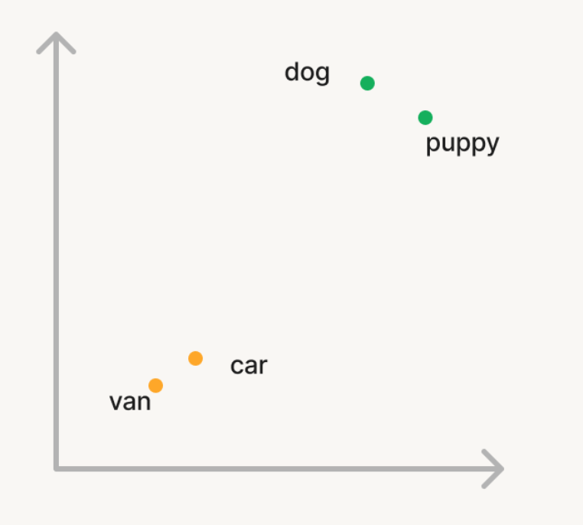
Embeddings are everywhere
Compressed, semantic representations of your data
Most advanced machine learning teams have used embeddings for years - but significant effort and expertise required
LLMs have made embeddings highly accessible, leading to an explosion in use cases

Slide 5
What is a Vector Database?
Scalable, reliable production service
Stores vector representation of your data, often including metadata
Offers query(...) interface to return the most similar vectors to a given query vector
Notes:
Note: Similarity search is often augmented with hard filters (which we support) or keyword-based queries (which we don’t yet support as of Oct 2023).

Slide 6
Common Vector Database use cases
Retrieval Augmented Generation (RAG, such as document Q&A)
Semantic search
Recommendations
Anomaly detection
…many others…
Notes:
Disvcussion: what other use cases do you have?

Slide 7
Agenda
What are embeddings? What are vector databases?
Product overview & benefits [Link]
Developer experience
Benchmark
Roadmap

Slide 8
Databricks Vector Search Product
Stores vector representation of your data, plus metadata
Tightly integrated with your Lakehouse
Scalable, low latency production service with zero operational overhead
Supports ACLs using Unity Catalog integration
API for real-time similarity search
Query can include filters on metadata
REST API and Python client

Slide 9
Databricks Vector Search benefits
Reliability and Performance
Scalable, reliable, and high-performance (QPS, latency, index performance)
Governance
Unity Catalog governance & lineage
Ease of use via native Lakehouse integration
Auto-syncs w/ source Delta Table - no complex pipelines.
Serverless: We handle all servers and infrastructure.
Metadata: Columns in Delta Table are automatically filters.
Embeddings: Automatically calls Model Serving for embedding generation.
Security and Trust
Comes with Databricks’ industry-leading security practices, security controls, compliance, and privacy guarantees. www.databricks.com/trust

Slide 10
Vector Search APIs
Chose an API variant that best suits your use case
3 API options | Ingestion pipelines | Embedding computation | Notes
Delta Sync API with managed embeddings | Automatic & managed | Managed, via Model Serving endpoint | Text only. Simplest.
Delta Sync API with self-managed embeddings | Automatic & managed | Self-managed | Any data.
Direct access CRUD API | Manual & self-managed | Self-managed | Any data. Most flexible.

Slide 11
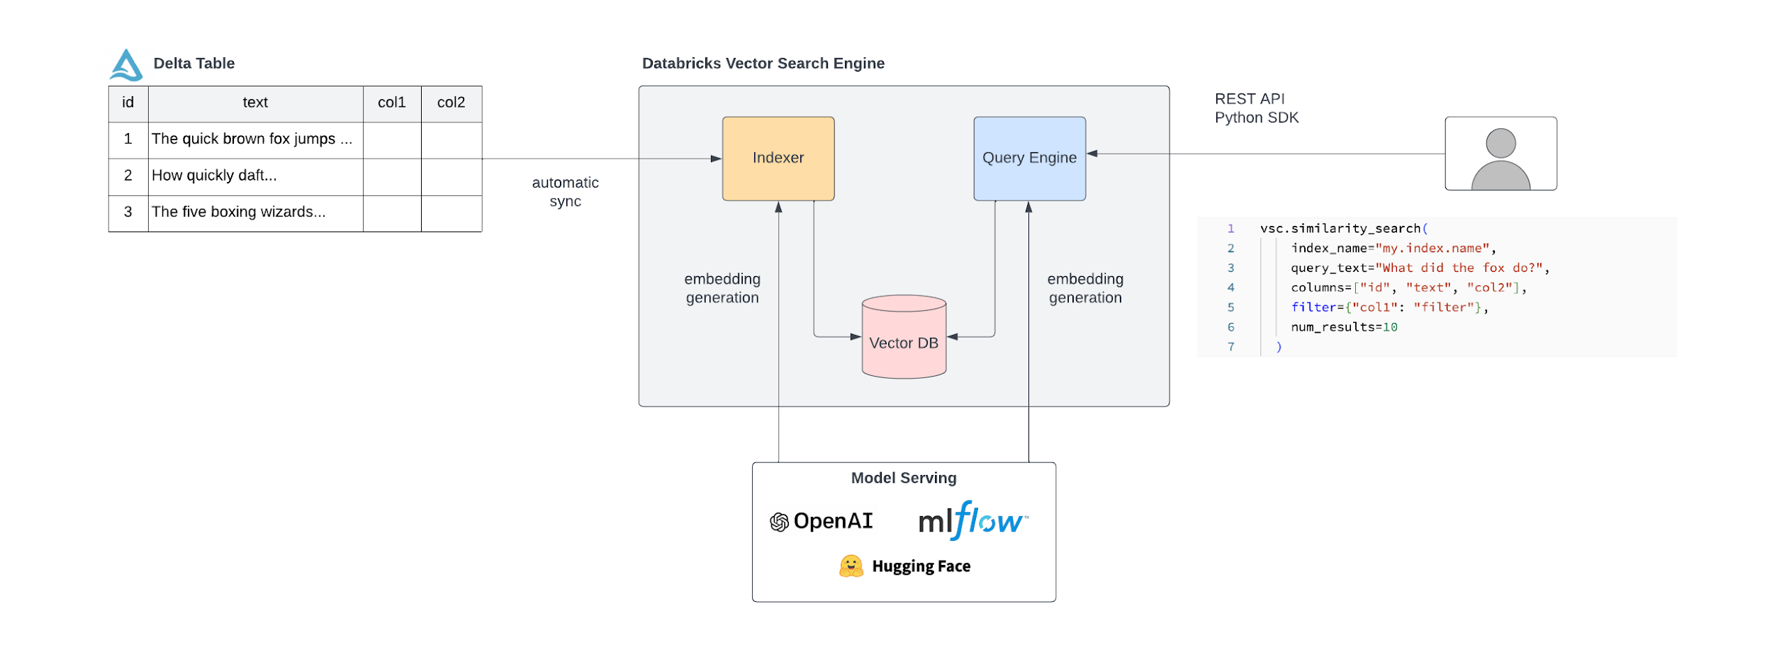
Delta Sync API w/ managed embeddings
Simple: automatic sync and fully managed embeddings
Notes:
TODO: Show ETL into Delta table?

Slide 12
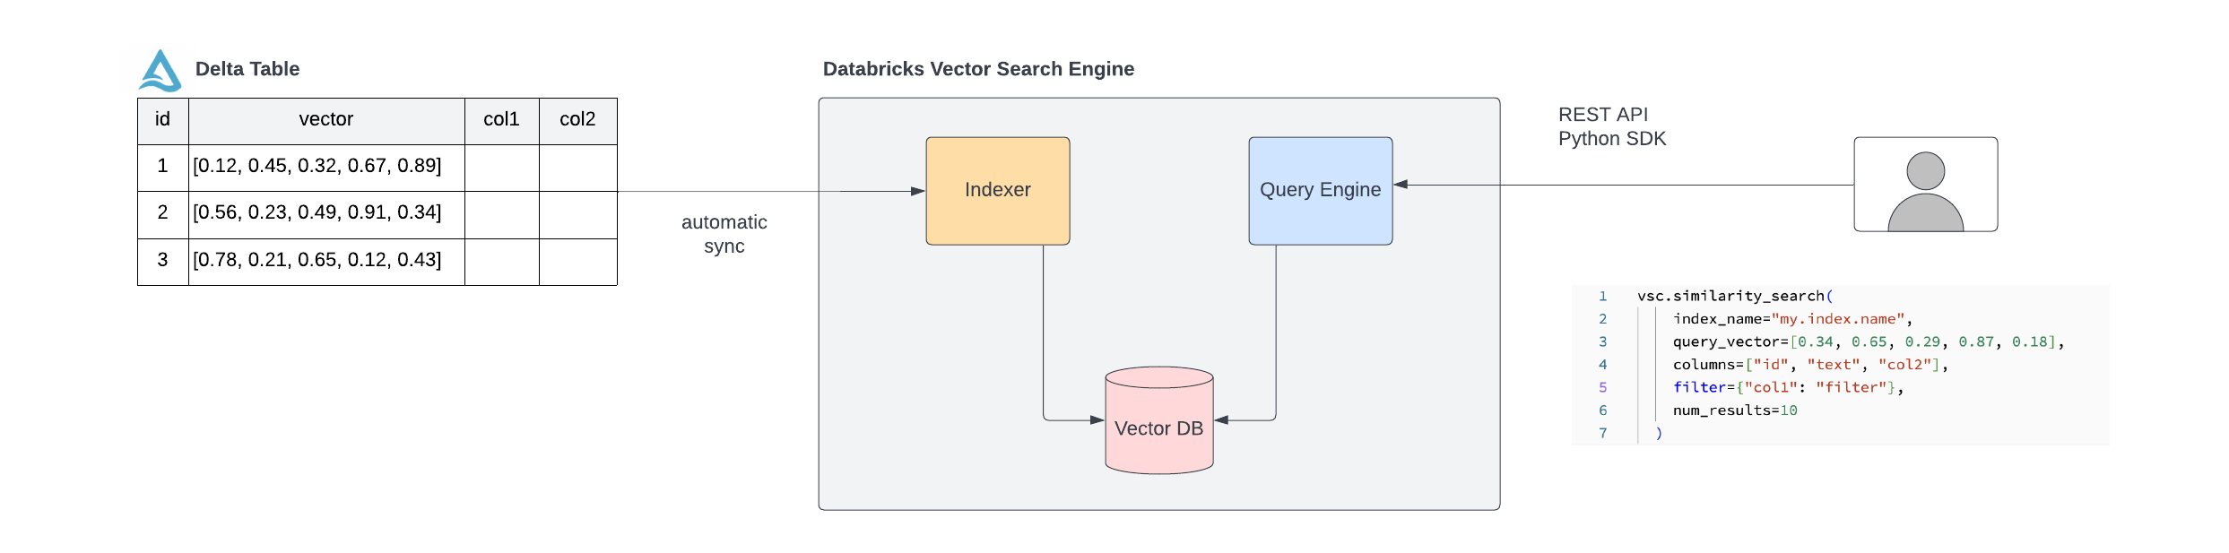
Delta Sync API w/ self-managed embeddings
Customizable: automatic sync and self-managed embeddings

Slide 13
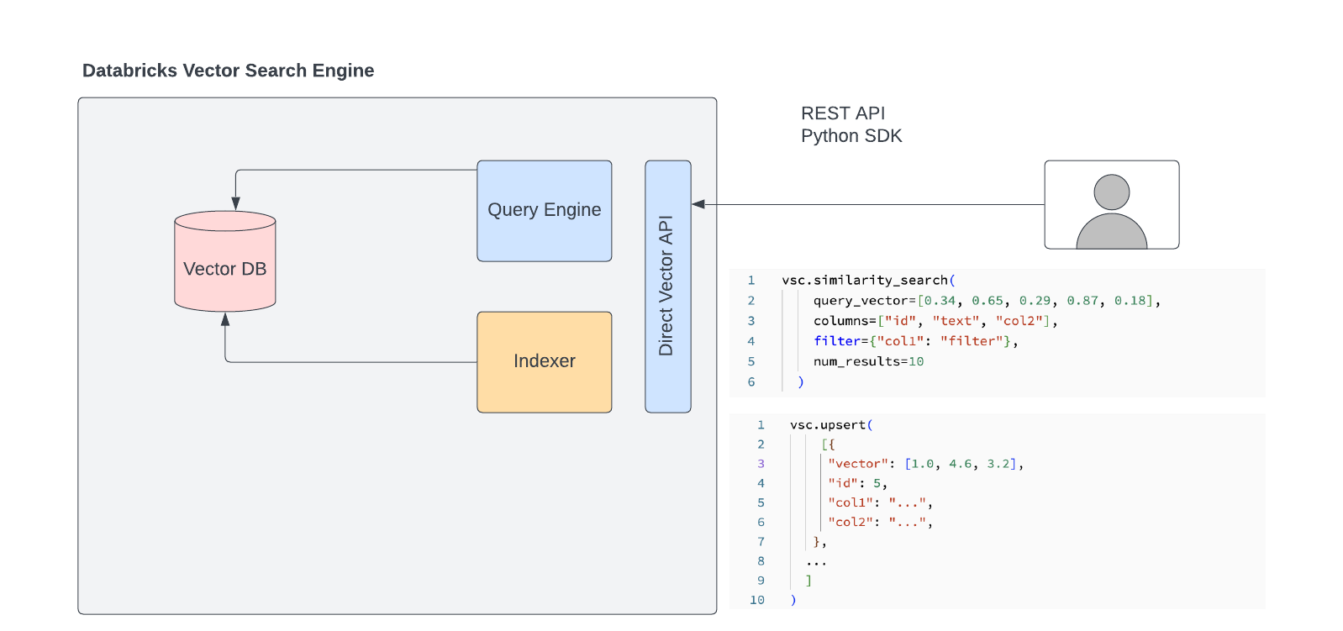
Direct access CRUD API
Flexible: manual sync via API, with self-managed embeddings

Slide 14
Key Concepts
Serverless model
Endpoint. Compute resources associated with vector search.
Workspace level
Multiple types
Standard
Storage optimized (future)
Performance optimized (future)
Vector Index. Table like entity in Unity Catalog.
Index level ACLs
Hosted by exactly one (1) endpoint
Delta Sync. Auto ingest UC-managed delta table to a vector index.
Uses Delta Live Tables (DLT) under the hood

Slide 15
Product Specifications
Feature | Specs (Public Preview/GA)
Endpoints / workspace | 10
Max # embeddings / endpoint | 100 million at 768 dim (can be across multiple indexes)
# indexes / endpoint | 50
Embeddings dimension | 4,096
Embeddings model | Any OpenAI, Open Source model logged in MLflow
Type of query | Filter + Vector
QPS | 10,000 QPS
Query latency | P95 50ms / P50 20ms Option for 150ms
Update latency (Delta Sync API) | <5 mins (variable throughput)
Requirements
Serverless, including Model Serving
Unity Catalog
GPU model serving if managed embedding models need GPUs
Notes:
See private preview documentation for more details.

Slide 16
Agenda
What are embeddings? What are vector databases?
Product overview & benefits [Link]
Developer experience
Benchmark
Roadmap

Slide 17
Developer Experience
Three modes of indexing vectors
Delta Sync API with managed embeddings
Databricks uses a customer provided embedding model to generate vectors for data in delta table.
Delta Sync API with un-managed embeddings
Customer provides embeddings as input either as a column in a delta table
Direct Vector API
Customer does insert/delete/update operations on vector index using CRUD API

Slide 18
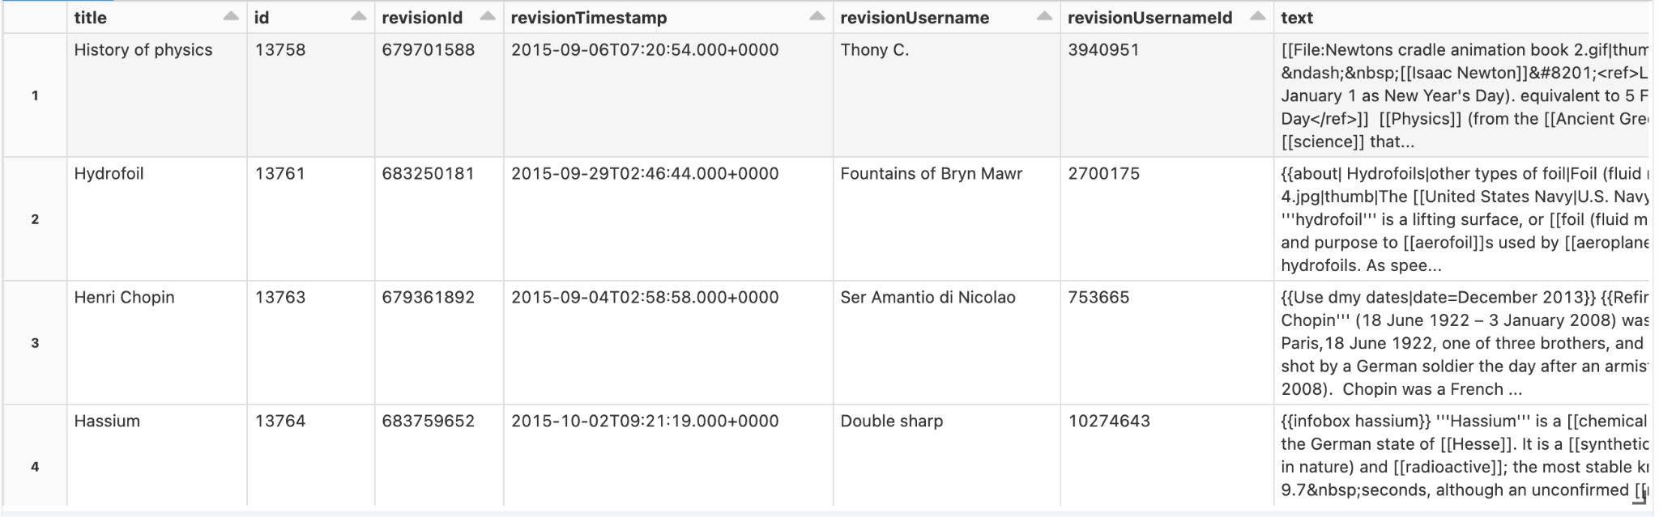
Developer Experience
Delta Sync API w/ managed embeddings
Embedding model used to create vectors
A Delta Table with wikipedia articles

Slide 19
Developer Experience
Delta Sync API w/ managed embeddings
Create a model serving end point for the embedding model
Embedding model used to create vectors

Slide 20
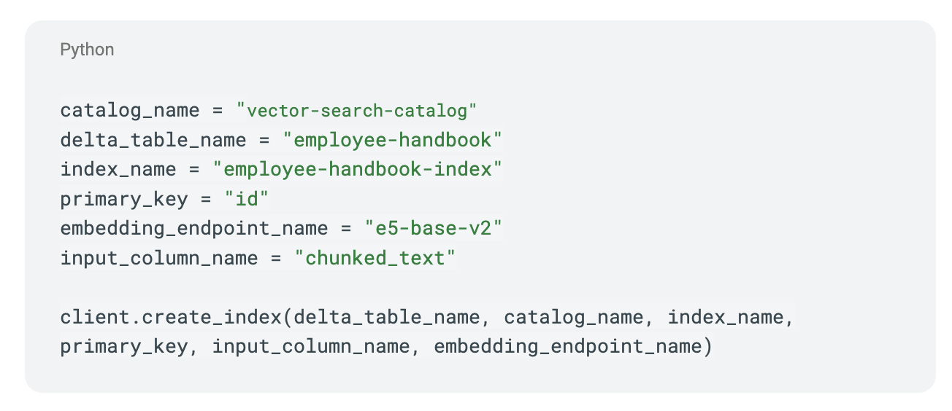
Developer Experience
Delta Sync API w/ managed embeddings
Create an index on a column from the delta table
Embedding model used to create vectors

Slide 21
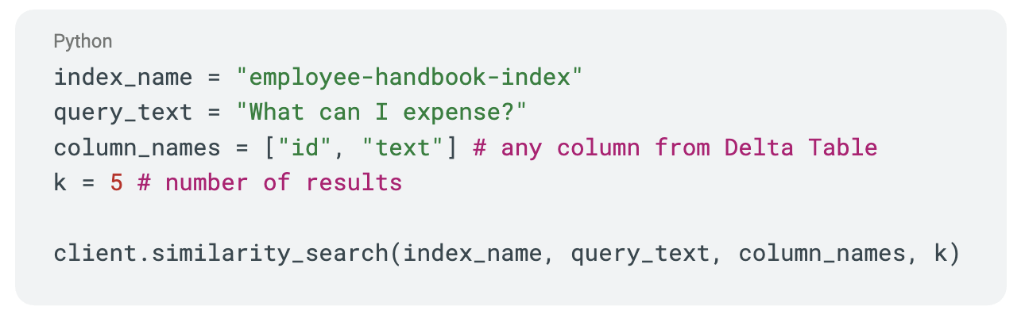
Developer Experience
Delta Sync API w/ managed embeddings
Query an index on a column from a delta table
Query converted to input vector for kNN search
Embedding model used to create vectors

Slide 22
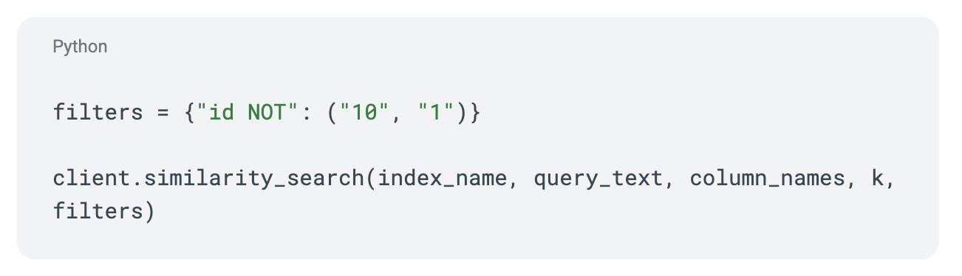
Developer Experience
Delta Sync API w/ managed embeddings
Query an index on a column from a delta table (w/ filters)
Query converted to input vector for kNN search
Embedding model used to create vectors

Slide 23
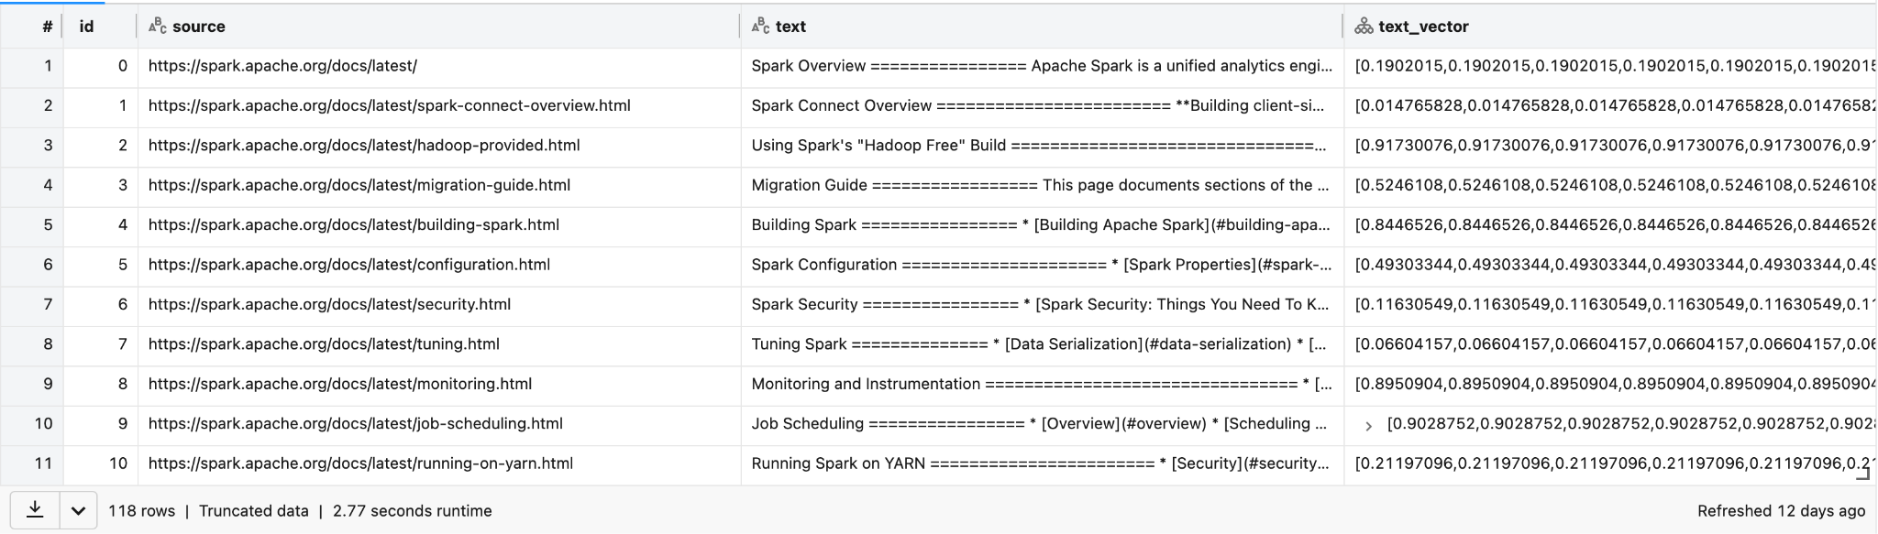
Developer Experience
Delta Sync API w/ unmanaged embeddings

Slide 24
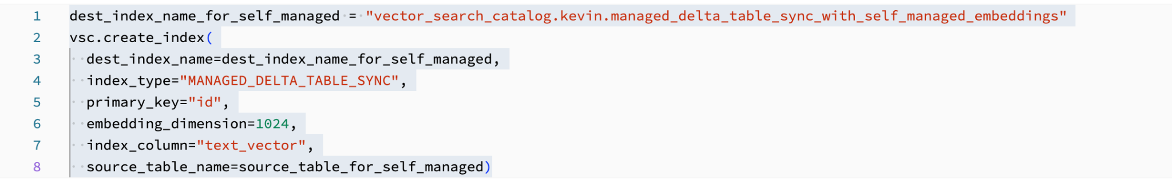
Developer Experience
Delta Sync API w/ unmanaged embeddings
Create an index on embeddings stored in a delta table

Slide 25
Developer Experience
Delta Sync API w/ unmanaged embeddings
Query an index for a vector

Slide 26
Developer Experience
Delta Sync API w/ unmanaged embeddings
Query an index for a vector (w/ filters)

Slide 27
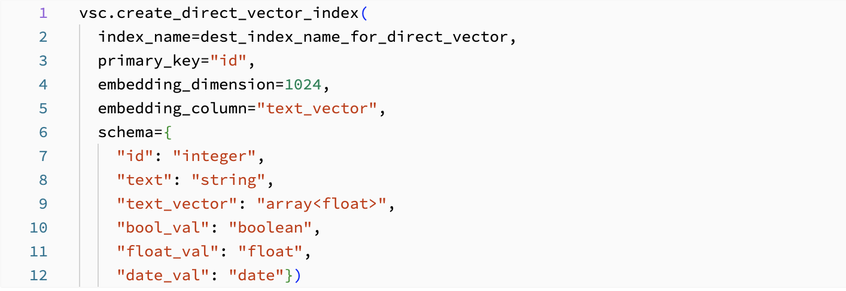
Developer Experience
Direct Vector API
Create an index on embeddings stored in a delta table

Slide 28
Developer Experience
Direct Vector API
Query an index for a vector

Slide 29
Developer Experience
API managed
Query an index for a vector (w/ filters)

Slide 30
Agenda
What are embeddings? What are vector databases?
Product overview & benefits [Link]
Developer experience
Benchmark
Roadmap

Slide 31
How we benchmarked
What we did:
Ingest and retrieve vectors
Process and fetch the metadata
Incorporate filtering scenarios
Datasets - DBPedia:
10k embeddings @ 1,536 dims; 1k test queries
100k embeddings @ 1,536 dims; 10k test queries
1M embeddings @ 1,536 dims; 10k test queries
100M embeddings; 10k test queries
Metrics:
Query latency (ms) - p50, p90, p99, p99.9
Recall @ K
Data ingestion time (minutes)

Slide 32
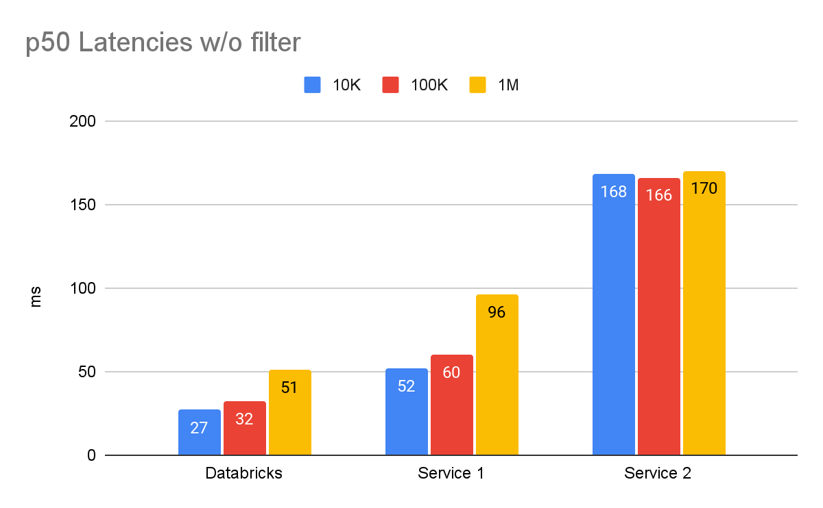
Without filters - query latency
Databricks | 10K | 100K | 1M
p50 | 27 | 32 | 51
p90 | 29 | 37 | 59
p99 | 40 | 45 | 67

Slide 33
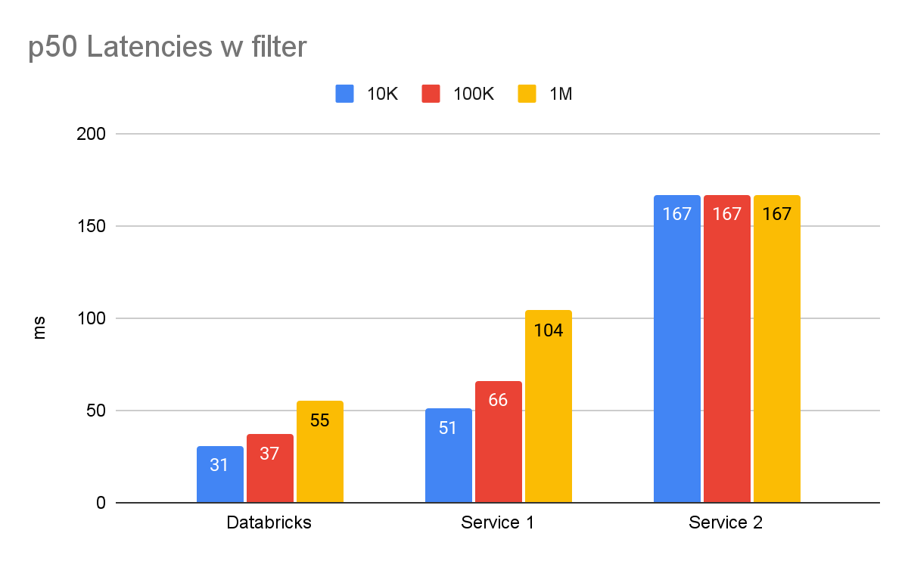
With filters - query latency
Databricks | 10K | 100K | 1M
p50 | 31 | 37 | 55
p90 | 34 | 45 | 66
p99 | 43 | 52 | 74

Slide 34
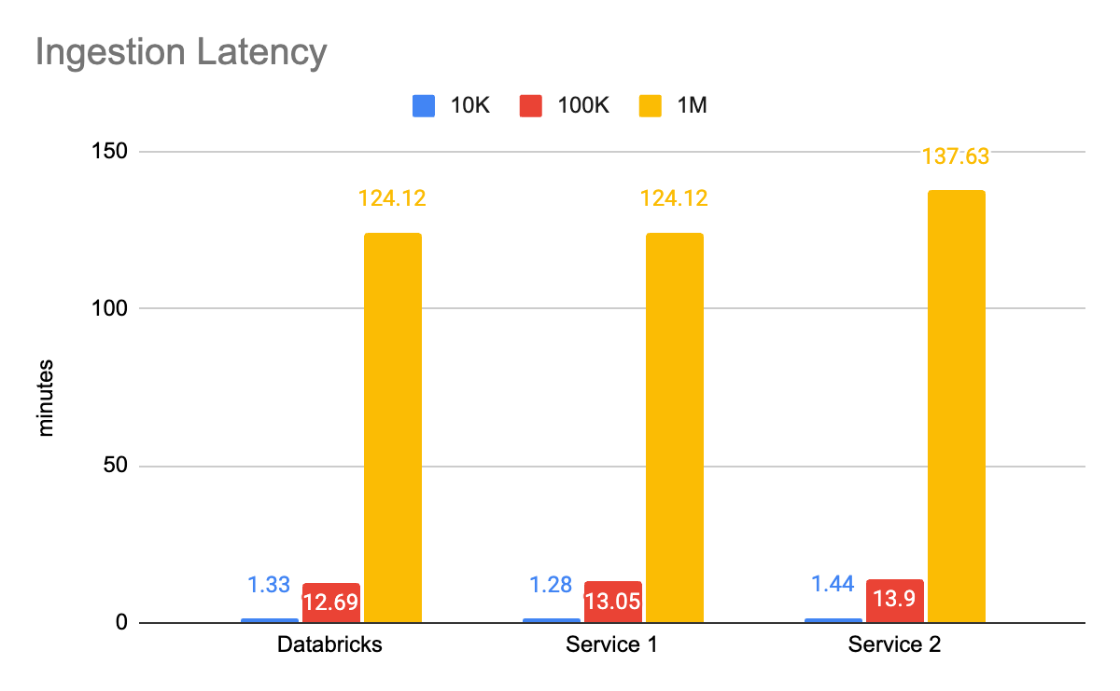
Ingestion time

Slide 35
Recall
>99.9%

Slide 36
Agenda
[ Optional ] What are embeddings? What are vector databases?
Product overview & benefits [Link]
Developer experience
Roadmap

Slide 37
Future Roadmap - Need Customer Input
Currently in Public Preview
Targeting Feb-March 24 for GA (subject to change)
Items under development and/or prioritization
Better monitoring/observability
System Tables
OTEL connectors for 3rd party monitoring systems
Hybrid Search: keyword + vector
Additional data types for managed Delta Sync API (e.g. image, video, etc.)
Security
Row Level ACLs
CMK
Audit Logging
Support IP ACLs and Private Links

Slide 38
Discussion topics

Slide 39
Appendix
Technical architecture
RAG architecture
Security

Slide 40
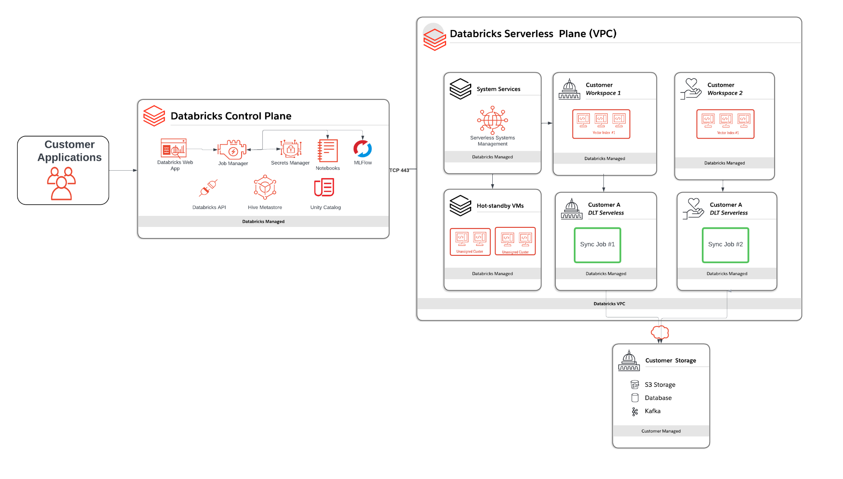
Technical Architecture

Slide 41
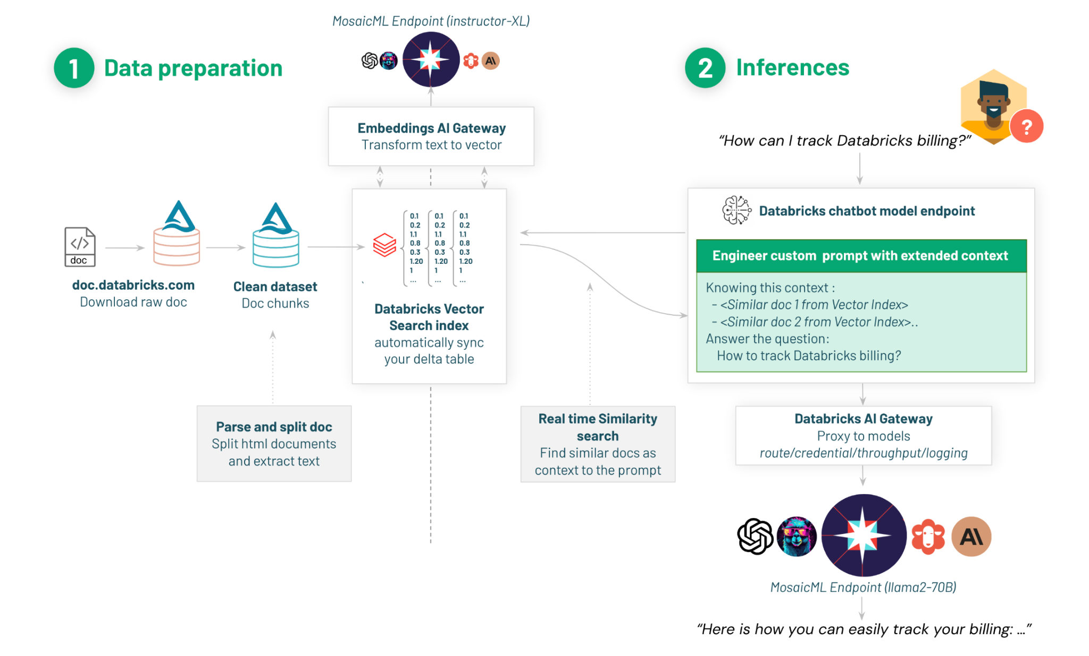
RAG Architecture

Slide 42
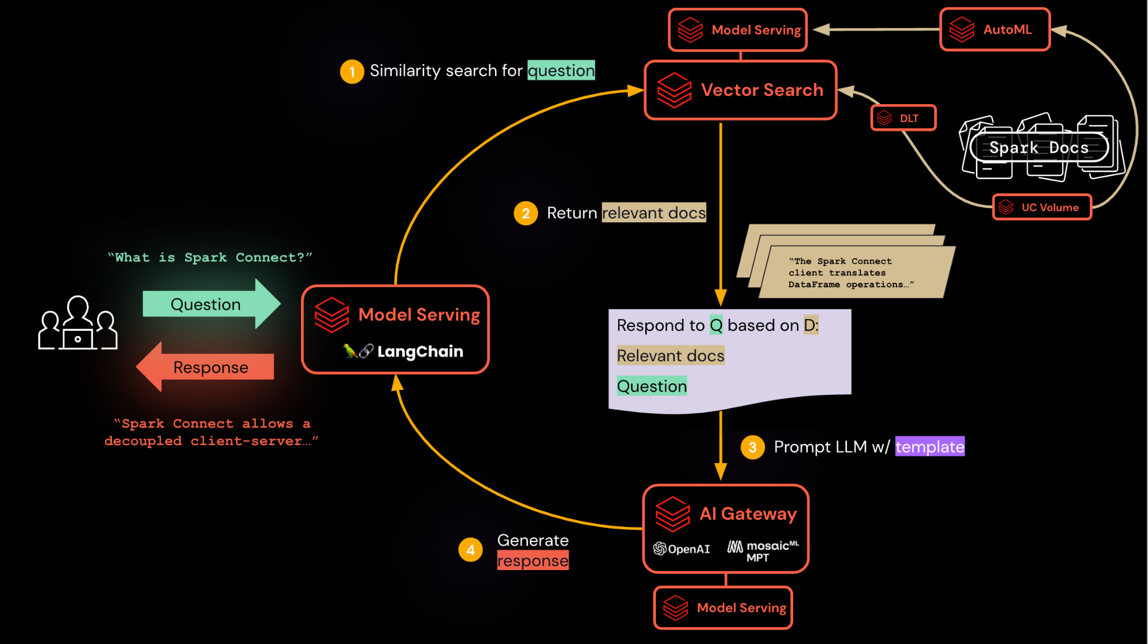
Blueprint for a Q&A bot

Slide 43




Databricks Vector Search
Serverless Vector Search is the simplest way to securely integrate vector searching with the Databricks Lakehouse Platform
A Modern Data Platform you can Trust
Simplified Security Responsibility
Complete Data Control
Secure by Design
Security is built into every layer of the Databricks Lakehouse Platform with data protection applied to your infrastructure, platform, and workloads that are consistent across clouds.
More simple means more secure. Stay ahead of emerging security threats and misconfigurations by automatically adopting Databricks industry-leading security best practices by the staff who know it best.
Maintain complete control over your data with a unified governance model and a consistent set of controls for data sharing and encryption.
Secure your workloads with multiple layers of isolation to ensure that compute clusters are 100% dedicated to you and never re-used.
Notes:
In today's competitive business landscape, balancing speed while ensuring the security of sensitive data and complying with industry regulations is paramount. The #1 cause of security issues in the cloud is security misconfigurations, and Gartner reports that through 2025, 99% of cloud security failures will be the customer’s fault. As customers adopt cloud data platforms, they can struggle to assess whether their deployments are well-architected, what areas are well-fortified and which need attention.
Thousands of customers rely on Databricks to process their data safely and securely and now will depend on Databricks to manage their compute clusters with serverless. While Databrick’s serverless offerings tout the benefits of better performance, reliability, and cost savings, they also can provide a simpler security experience for you. Databricks Serverless allows you to focus on solving your data problems at scale by leaving lakehouse security to the experts who know it best (or another option above).
Databricks has securely processed customer data in the cloud for almost a decade. Our world-class security team sits at the forefront of innovation for securing the lakehouse platform at every layer. We have applied the same security practices to our serverless products with benefits like security health monitoring from our Security Analysis Tool and automatic security updates. With serverless, you still have complete control over your data. We provide you with all of the security controls you need to share, govern, and control your data with capabilities like fine-grained access control and customer-managed keys. And rest assured your workloads are protected with multiple layers of isolation to ensure that compute clusters are 100% dedicated to you and never re-used.
Try serverless today and see why the most secure modern data platform is a lakehouse.

Slide 44
Multiple Layers of Isolation
Customer workloads are protected by multiple layers of isolation
Vector Search
Access is placed to the Databricks Vector Search API in the Control Plane
User access is controlled by Unity Catalog
Data
All local and attached disks are dedicated to one customer
All storage is encrypted at rest using AES 256
Data is destroyed using cloud native services when terminated
Compute
Dedicated to a customer & wiped after use
No privileges or credentials for other systems
Network
No public IP addresses are used
No outbound connectivity is allowed
Ingress traffic from authorized sources only
Vector
Search
Disks
Compute
Network
Notes:
Definition of “wiped” varies based on local SSD versus network and by cloud. We make sure that the storage is securely wiped in the way most appropriate for the cloud and the storage. We do not do repeat overwrites of the disk (not common and not practical)
What does compute mean? We will converge on “cloud instance” in Q3 but until then:
AWS - VM from AWS
Azure - today it means a VM running on a databricks-controller hypervisor that runs on a Azure physical box. In ~Q3 it will mean VM from Azure

Slide 45
Data access control
2 areas in which you need to control data access:
Application-level management
For managing access for users of an application which calls Vector Search.
Control data access via metadata filtering in vector index queries.
Data platform-level management
For managing access for developers using shared vector indexes.
Control data access via vector index ACLs, managed by UC.
Currently available only at coarse-grained (index-level) ACLs; finer-grained ACLs are under prioritization.

Slide 46
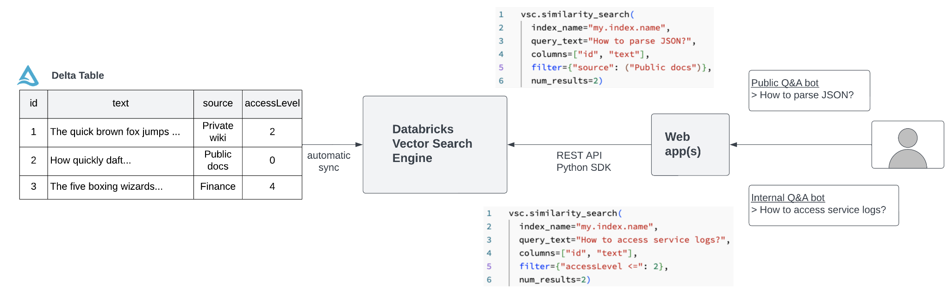
Data access control: Application-level

Slide 47
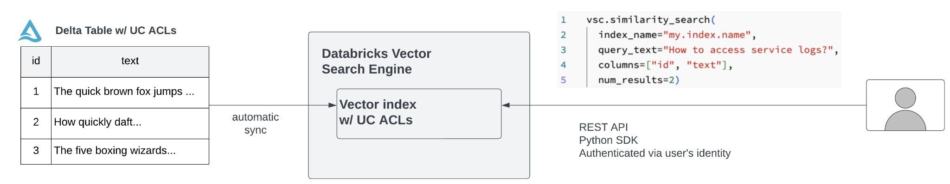
Data access control: Developer-level

